Slide 1

Analysis of Inertia-Weighted Redundancy Resolution
Bartoli Ermanno - 1794103
Argenziano Francesco - 1957976
Academic Year: 2020-2021
Ermanno Bartoli 1794103
Francesco Argenziano 1957976

Slide 2
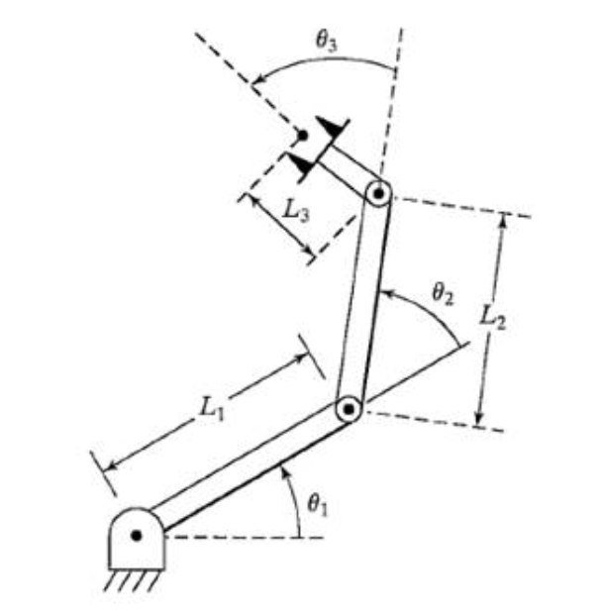
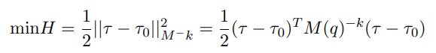
Introduction to the problem
Goal of this project was to analyze the performance of a 3R robot redundant w.r.t. a specific task
The seek for the solution is done through Jacobian-based methods at the second differential level
While achieving the task, the robot must also minimize the objective function:
for different k values.

Slide 3
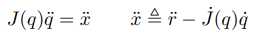
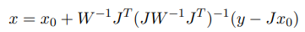
LQ Optimization
The solution of our problem is obtained in the linear quadratic optimization framework;
We have
subjected to
The general solution to a LQ problem is
in the form

Slide 4
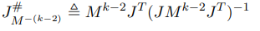
General solution
After doing some algebraic manipulations to get to the general formulation, we can apply the general solution to our specific problem
Our solution to this optimization problem is:
where
it’s the weighted pseudoinverse of J

Slide 5
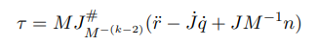
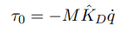
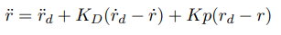
Additional comments to the solution
In absence of the damping factor, the solution simply becomes:
In presence of the damping factor, we’ve chosen it as:
Since we want that the robot follows the task, we also include a controller in order to recover from task error:

Slide 6
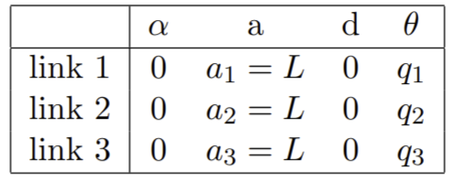
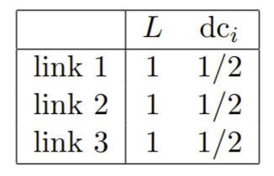
Simulation Setup - Robot Structure
The table shows the DH parameters of the robot
the table shows the length of the links and the distances of the center of masses

Slide 7
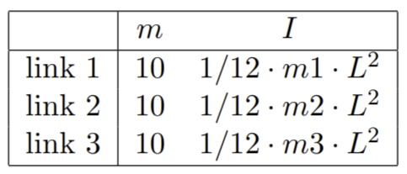
Simulation Setup - Dynamic Parameters
This table shows the masses and the inertia values for the links
OBS:

Slide 8
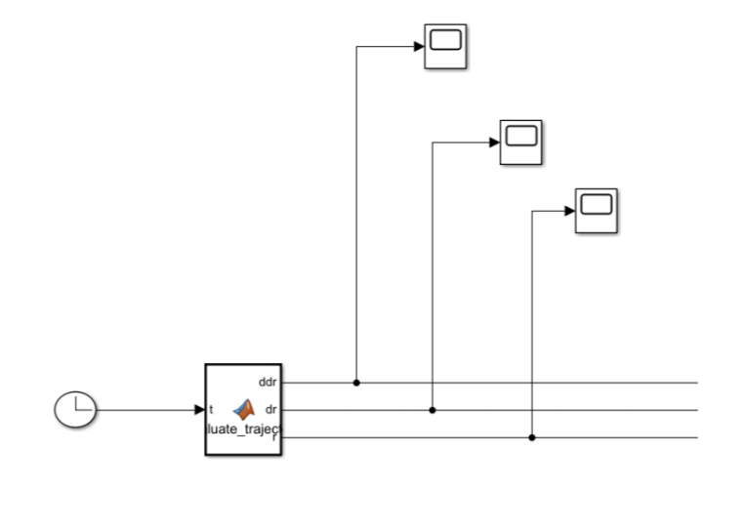
Simulink Model (1)
This figure shows the first part of the model that we built on using simulink, the second part is showed in the following slide

Slide 9
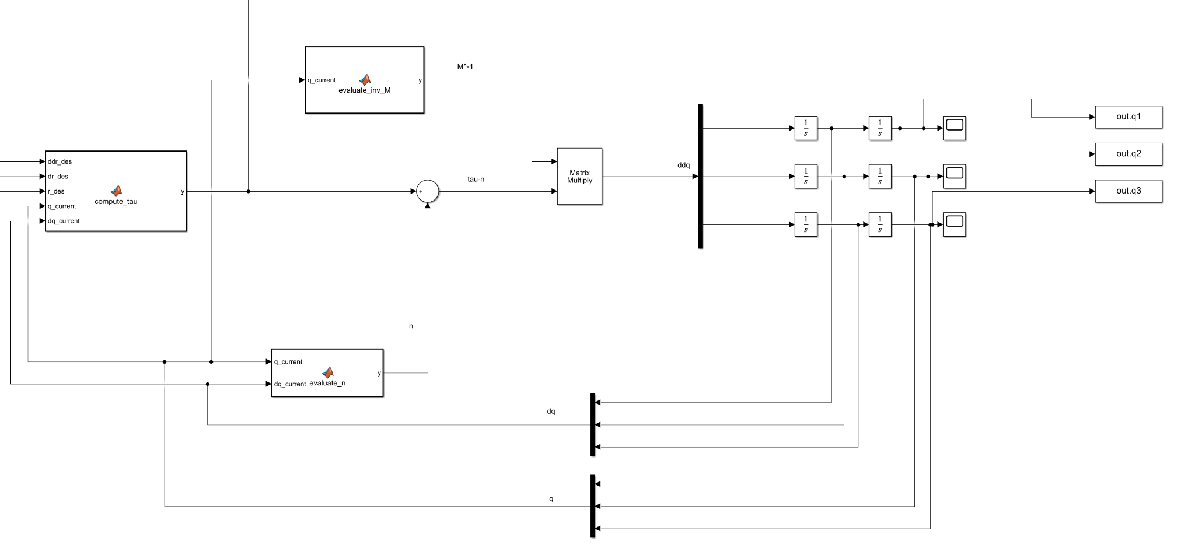
Simulink Model (2)

Slide 10
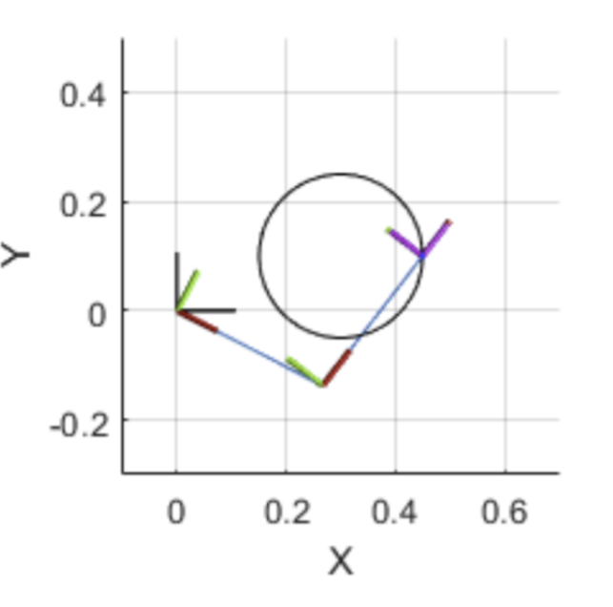
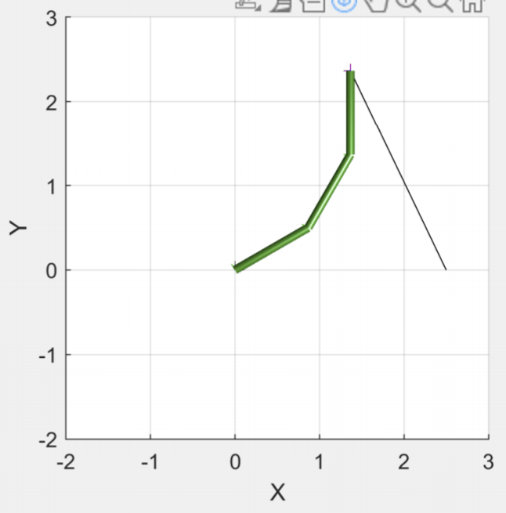
Matlab Robotics System Toolbox
We used Matlab Robotics System Toolbox to visualize the motion of the robot.
In order to make the robot more realistic, we added collisionCylinders on the links
Robot without collisionCylinders
Robot with collisionCylinders

Slide 11
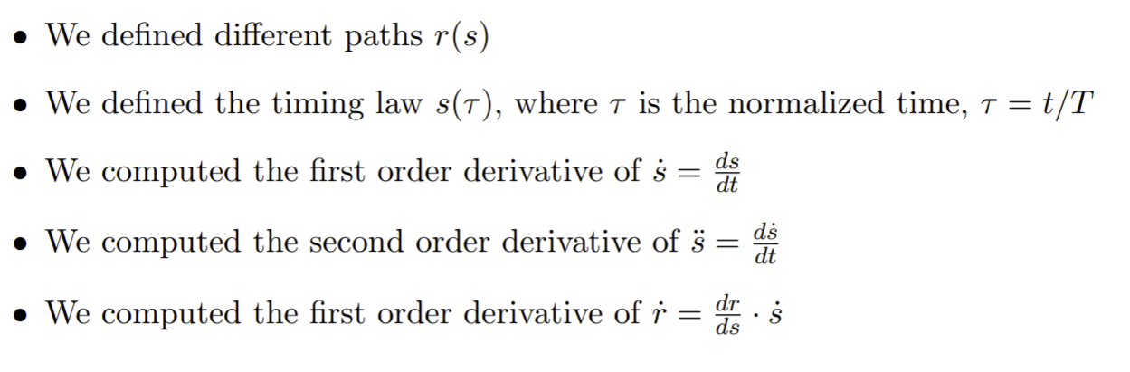
Generation of trajectories (1)
For the generation of trajectories:

Slide 12
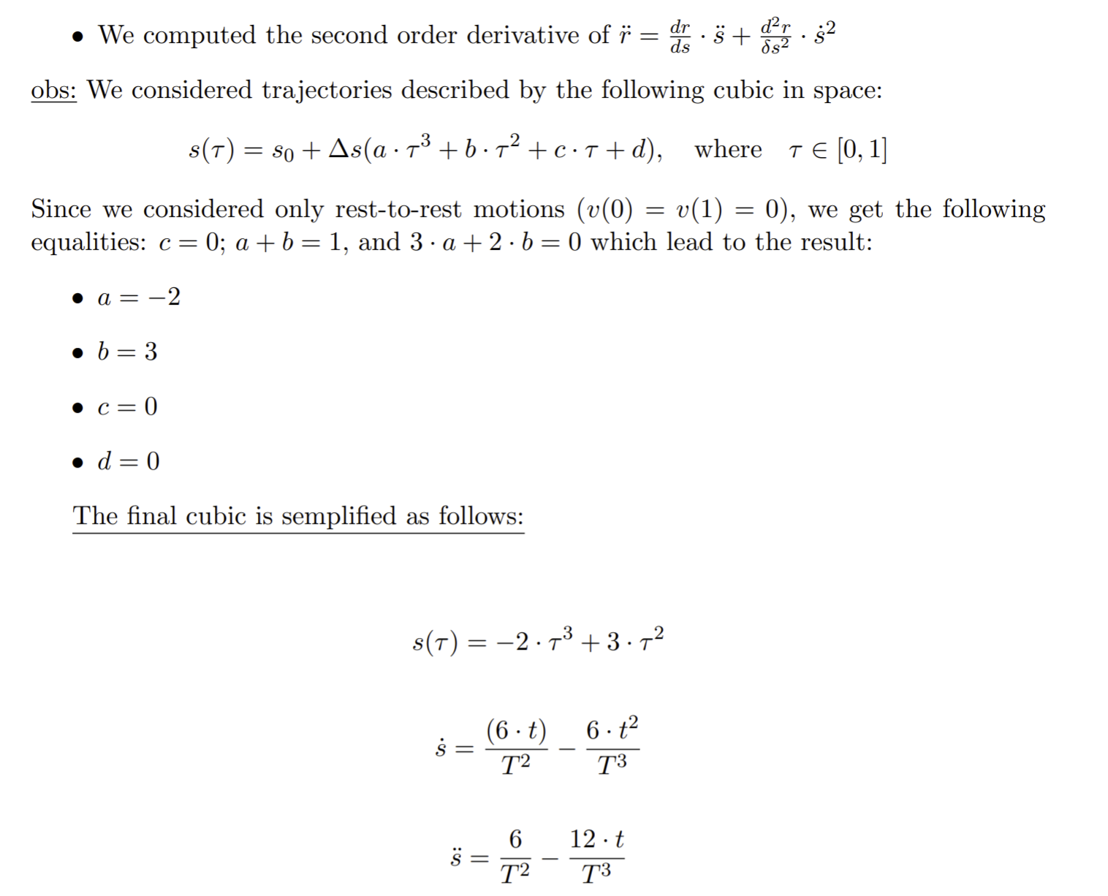
Generation of trajectories (2)

Slide 13
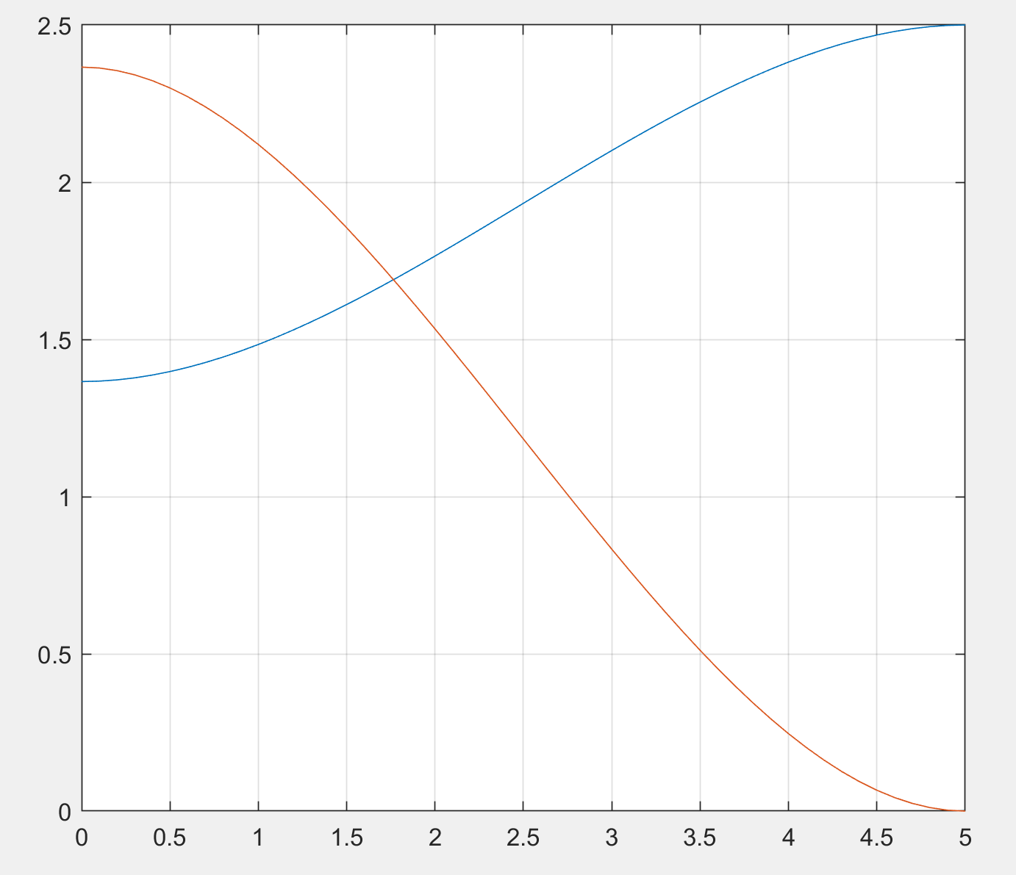
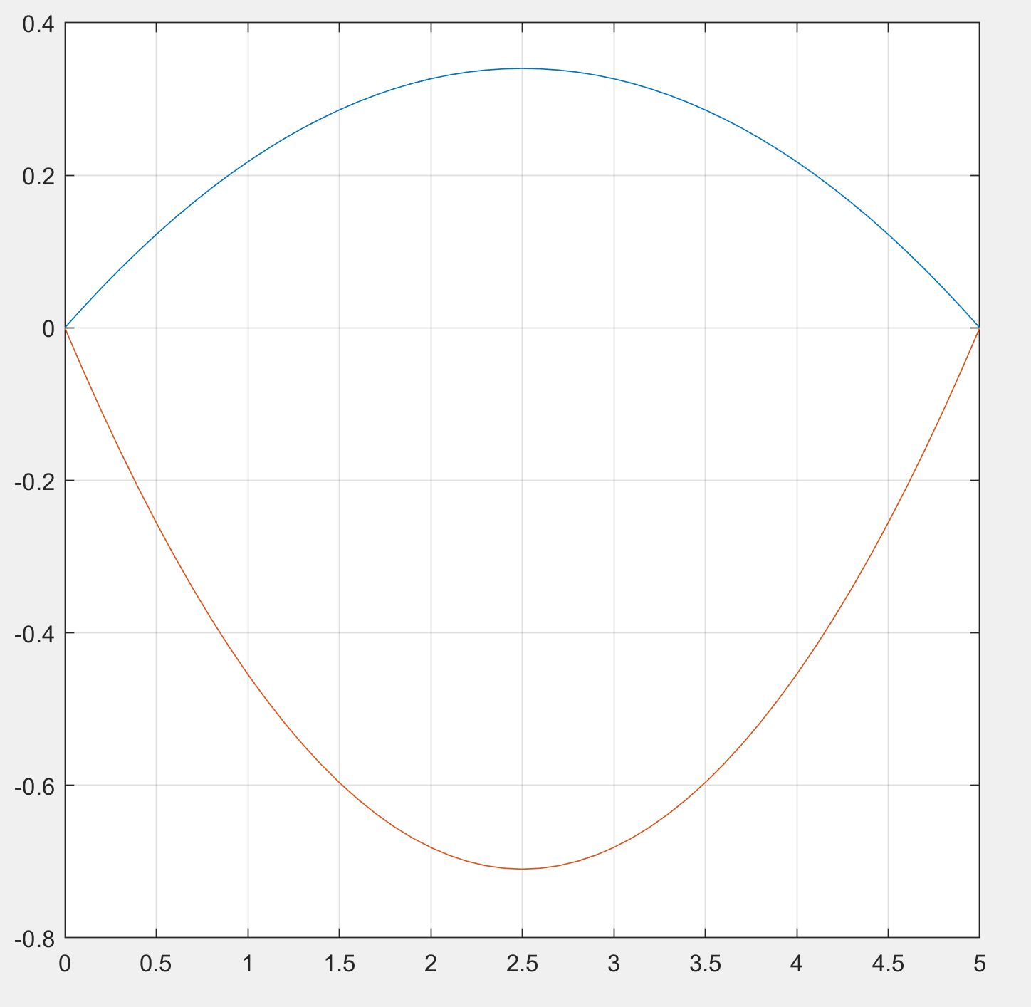
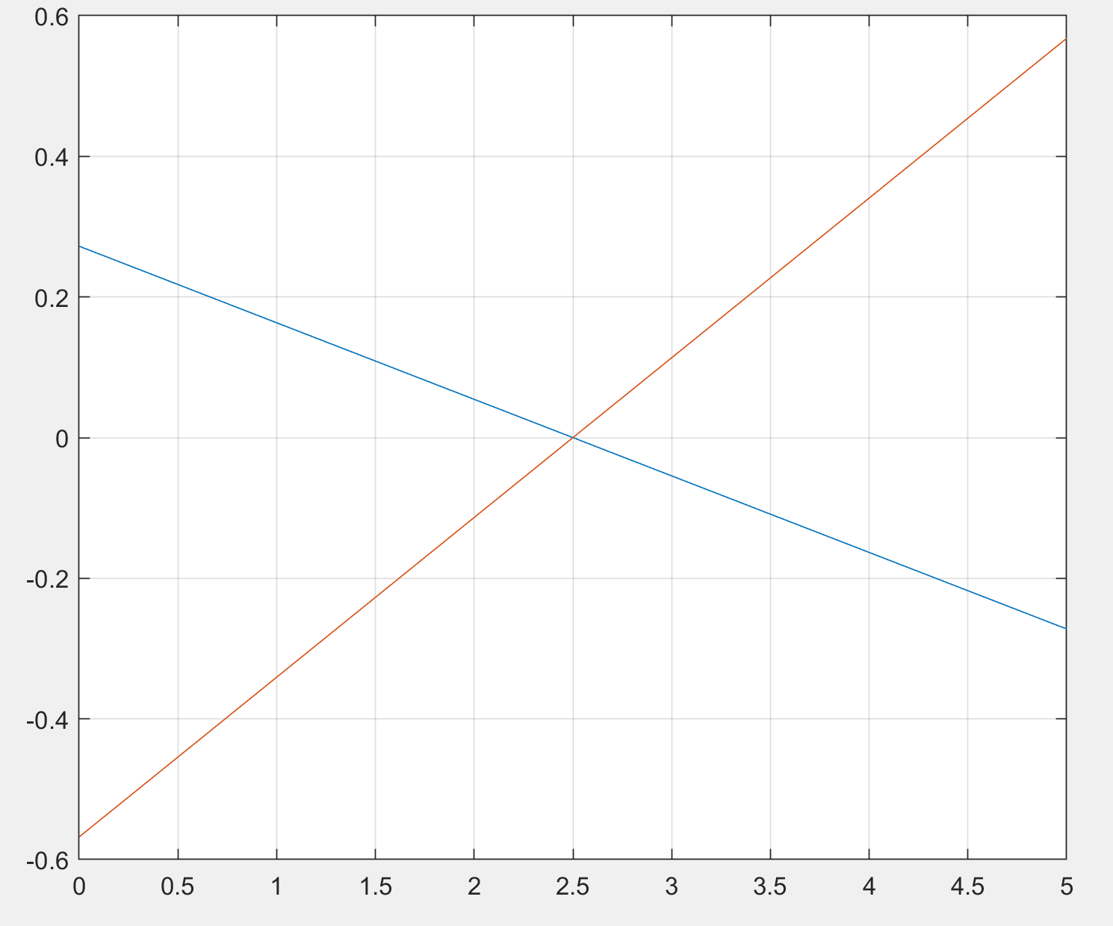
Linear Path

Slide 14
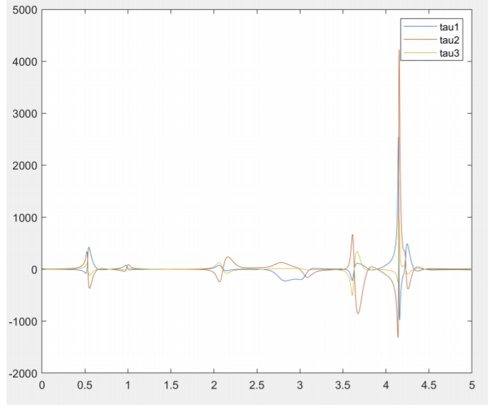
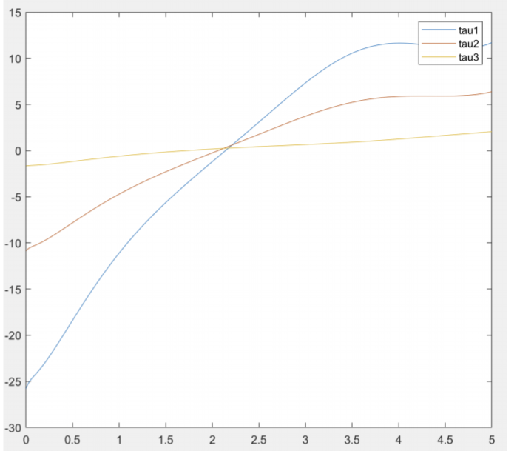
Results on a linear path - Absence of gravity term (1)
tau values for k = -1
tau values for k = 2

Slide 15
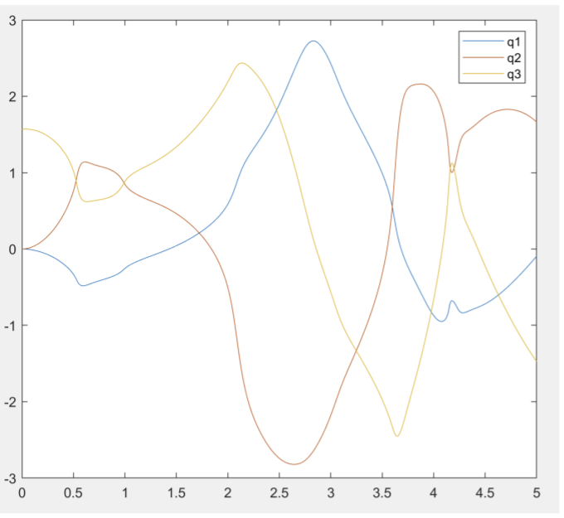
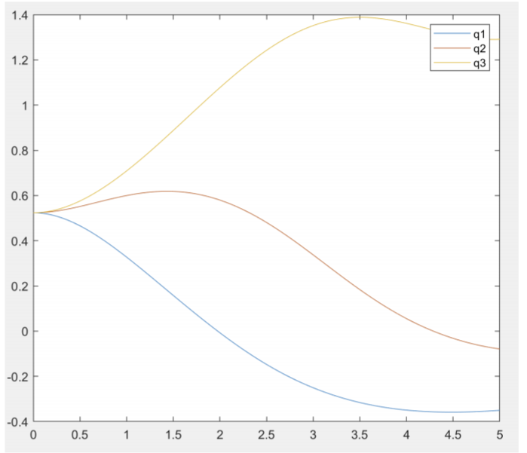
Results on a linear path - Absence of gravity term (2)
joint values for k = -1
joint values for k = 2

Slide 16
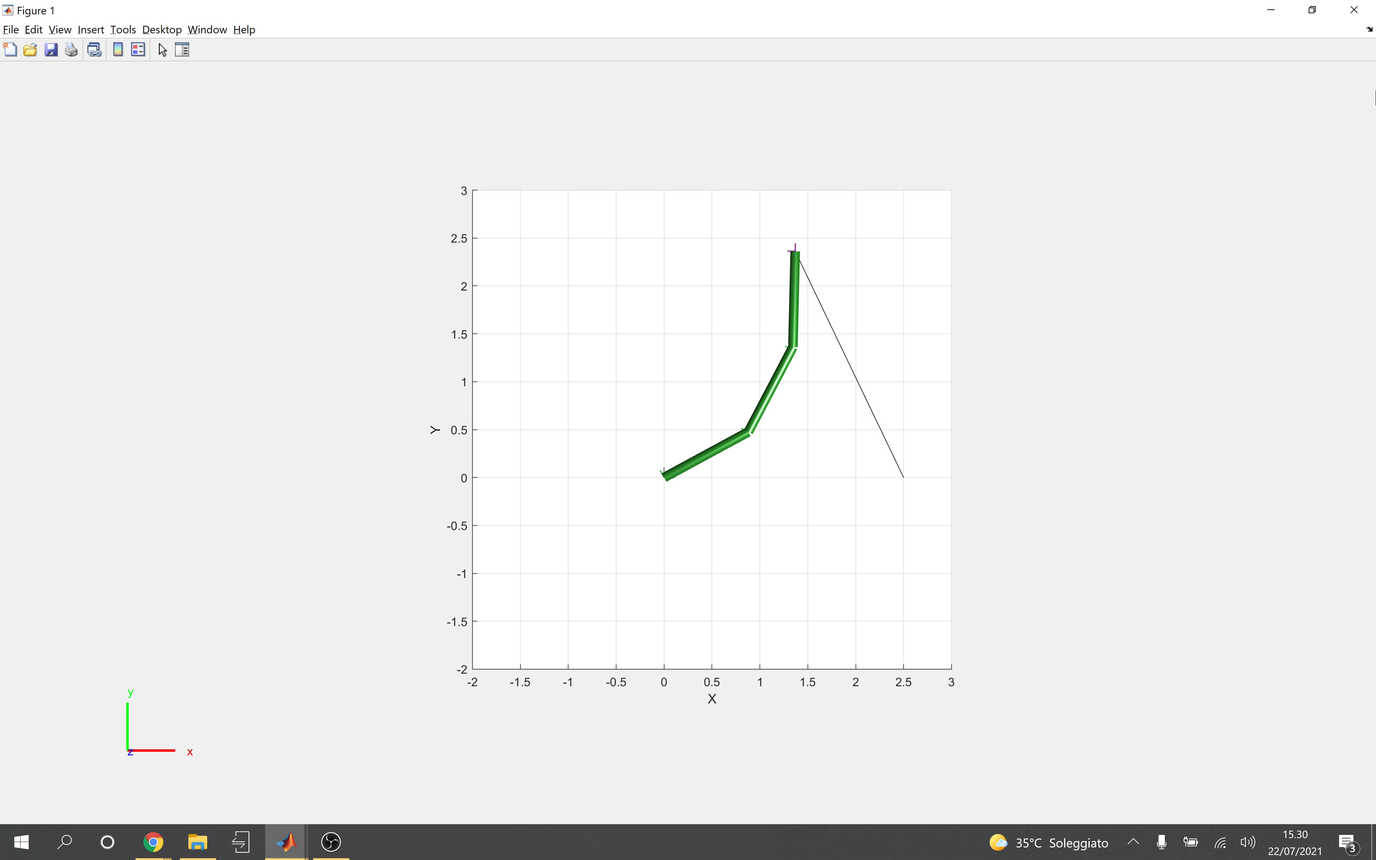
Results on a linear path - Absence of gravity term (3)
K = -1

Slide 17

Results on a linear path - Absence of gravity term (4)
K = 2

Slide 18

Results on a linear path – Presence of gravity term (1)
K = -1

Slide 19

Results on a linear path – Presence of gravity term (2)
K = 2

Slide 20
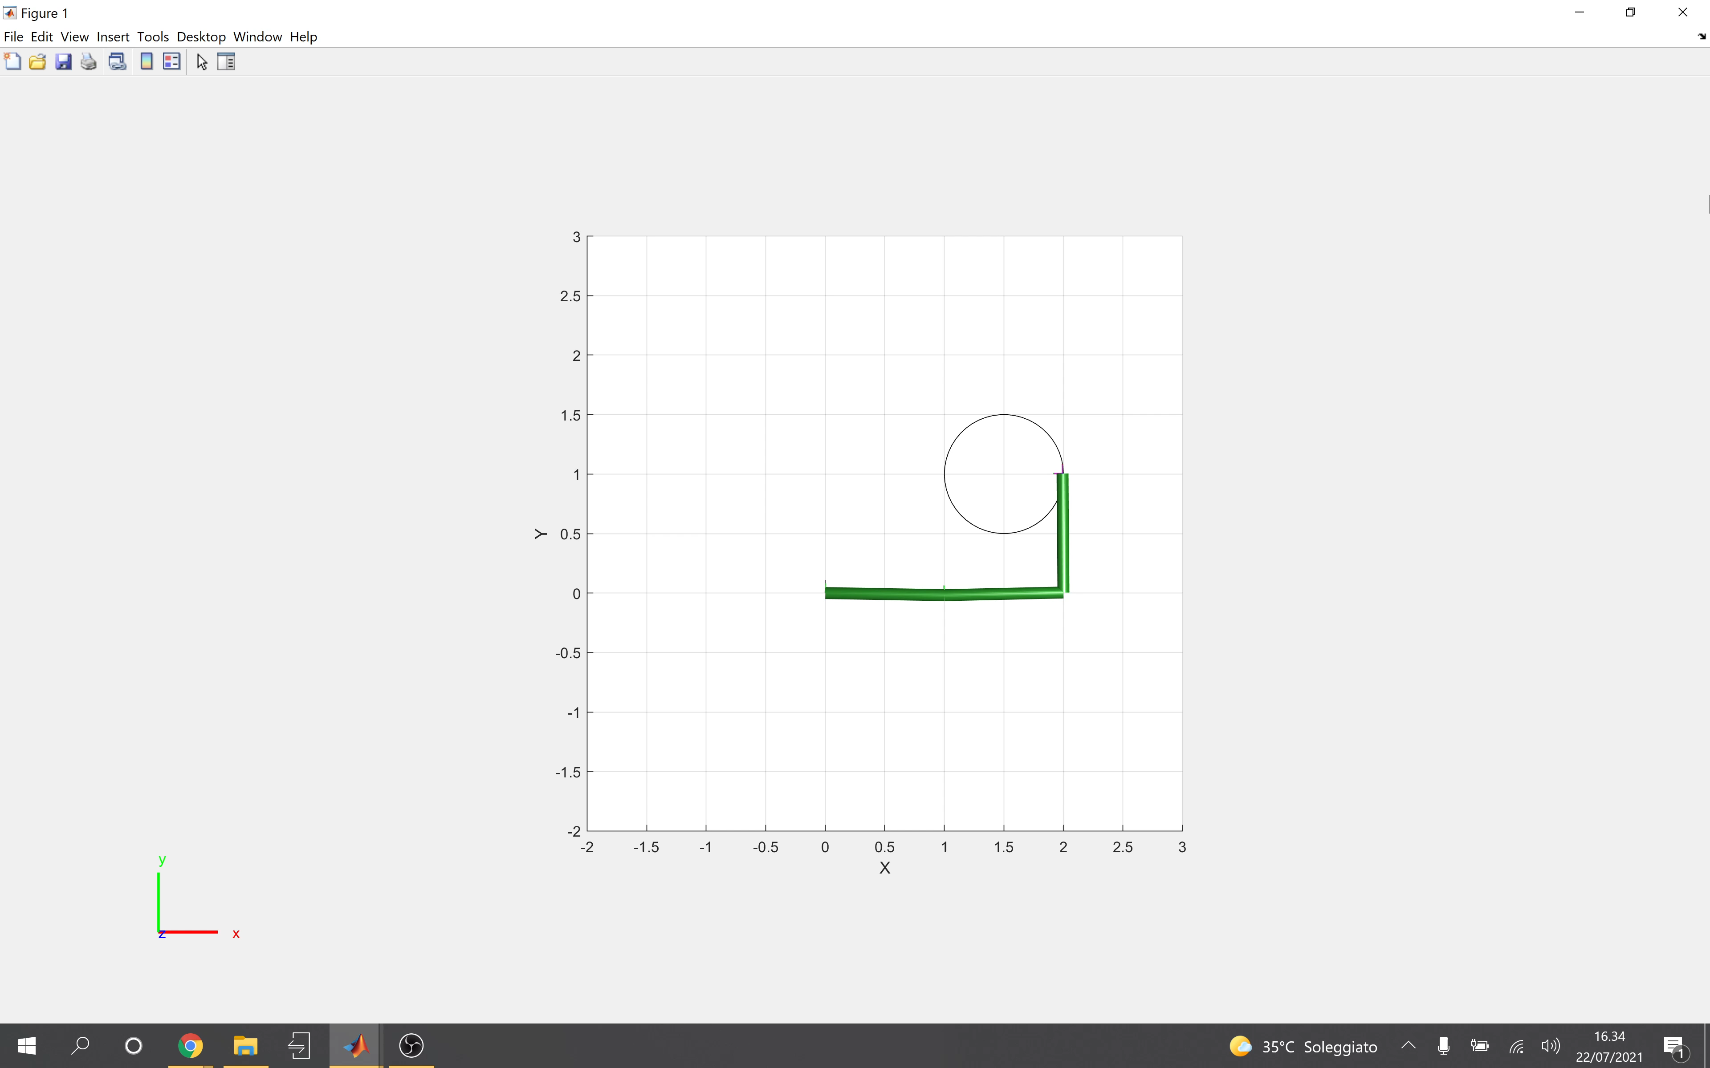
Results on a circular path– Absence of gravity term (1)
K = -1

Slide 21

Results on a circular path– Absence of gravity term (2)
K = 2

Slide 22
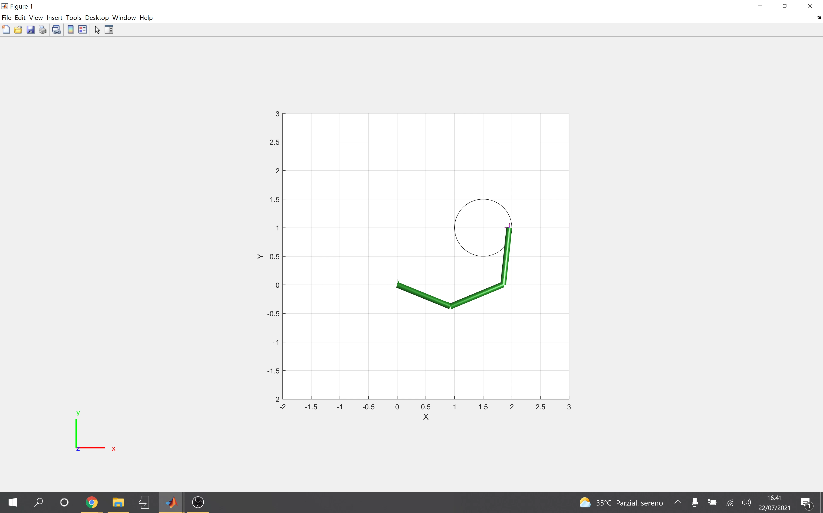
Results on a circular path– Presence of gravity term (1)
K = -1

Slide 23
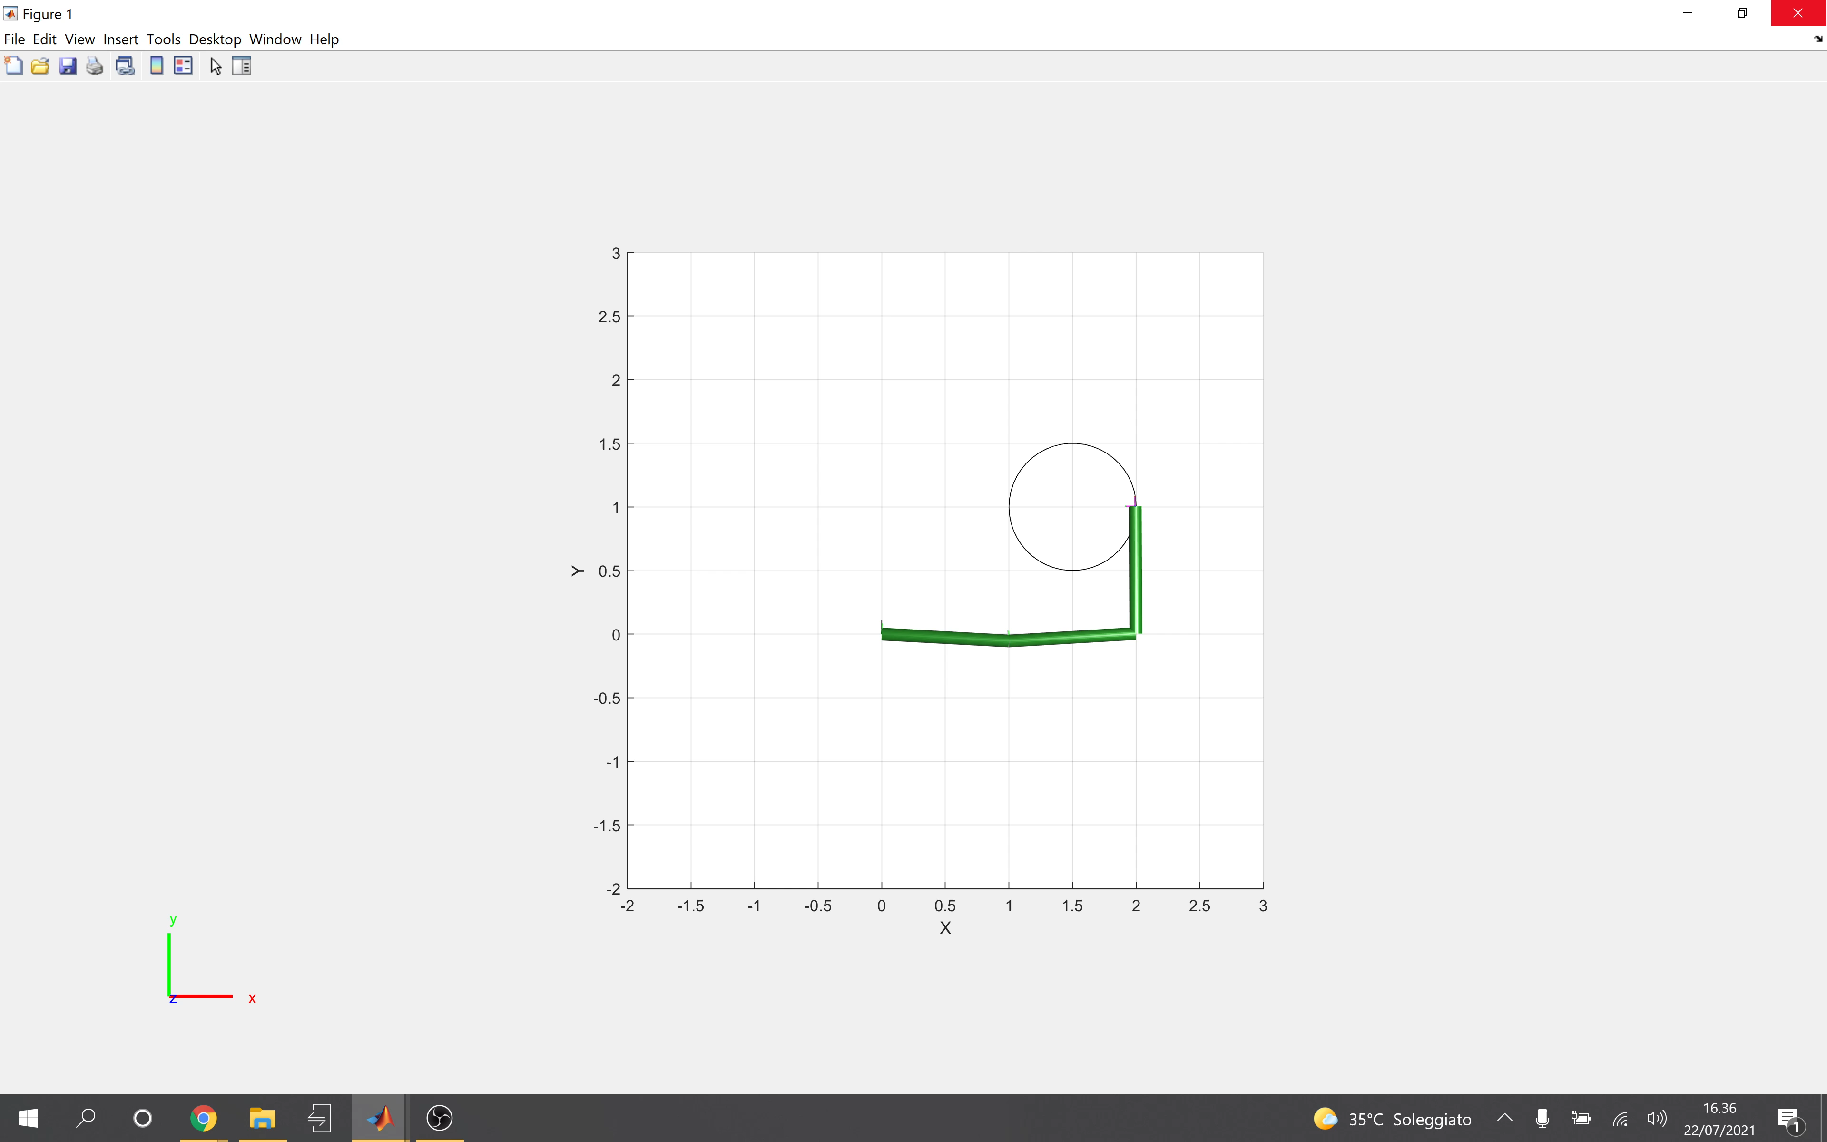
Results on a circular path– Presence of gravity term (2)
K = 2

Slide 24

Why a damping factor is useful?
In this video, the robot was asked to hold the end-effector stuck in a point.
This task, which is trivial without the presence of gravity, becomes more interesting with the presence of it, because at every instant a tau which contrast the gravity have to be generated, and the end-effector has to be held to the point.
K = 2

Slide 25
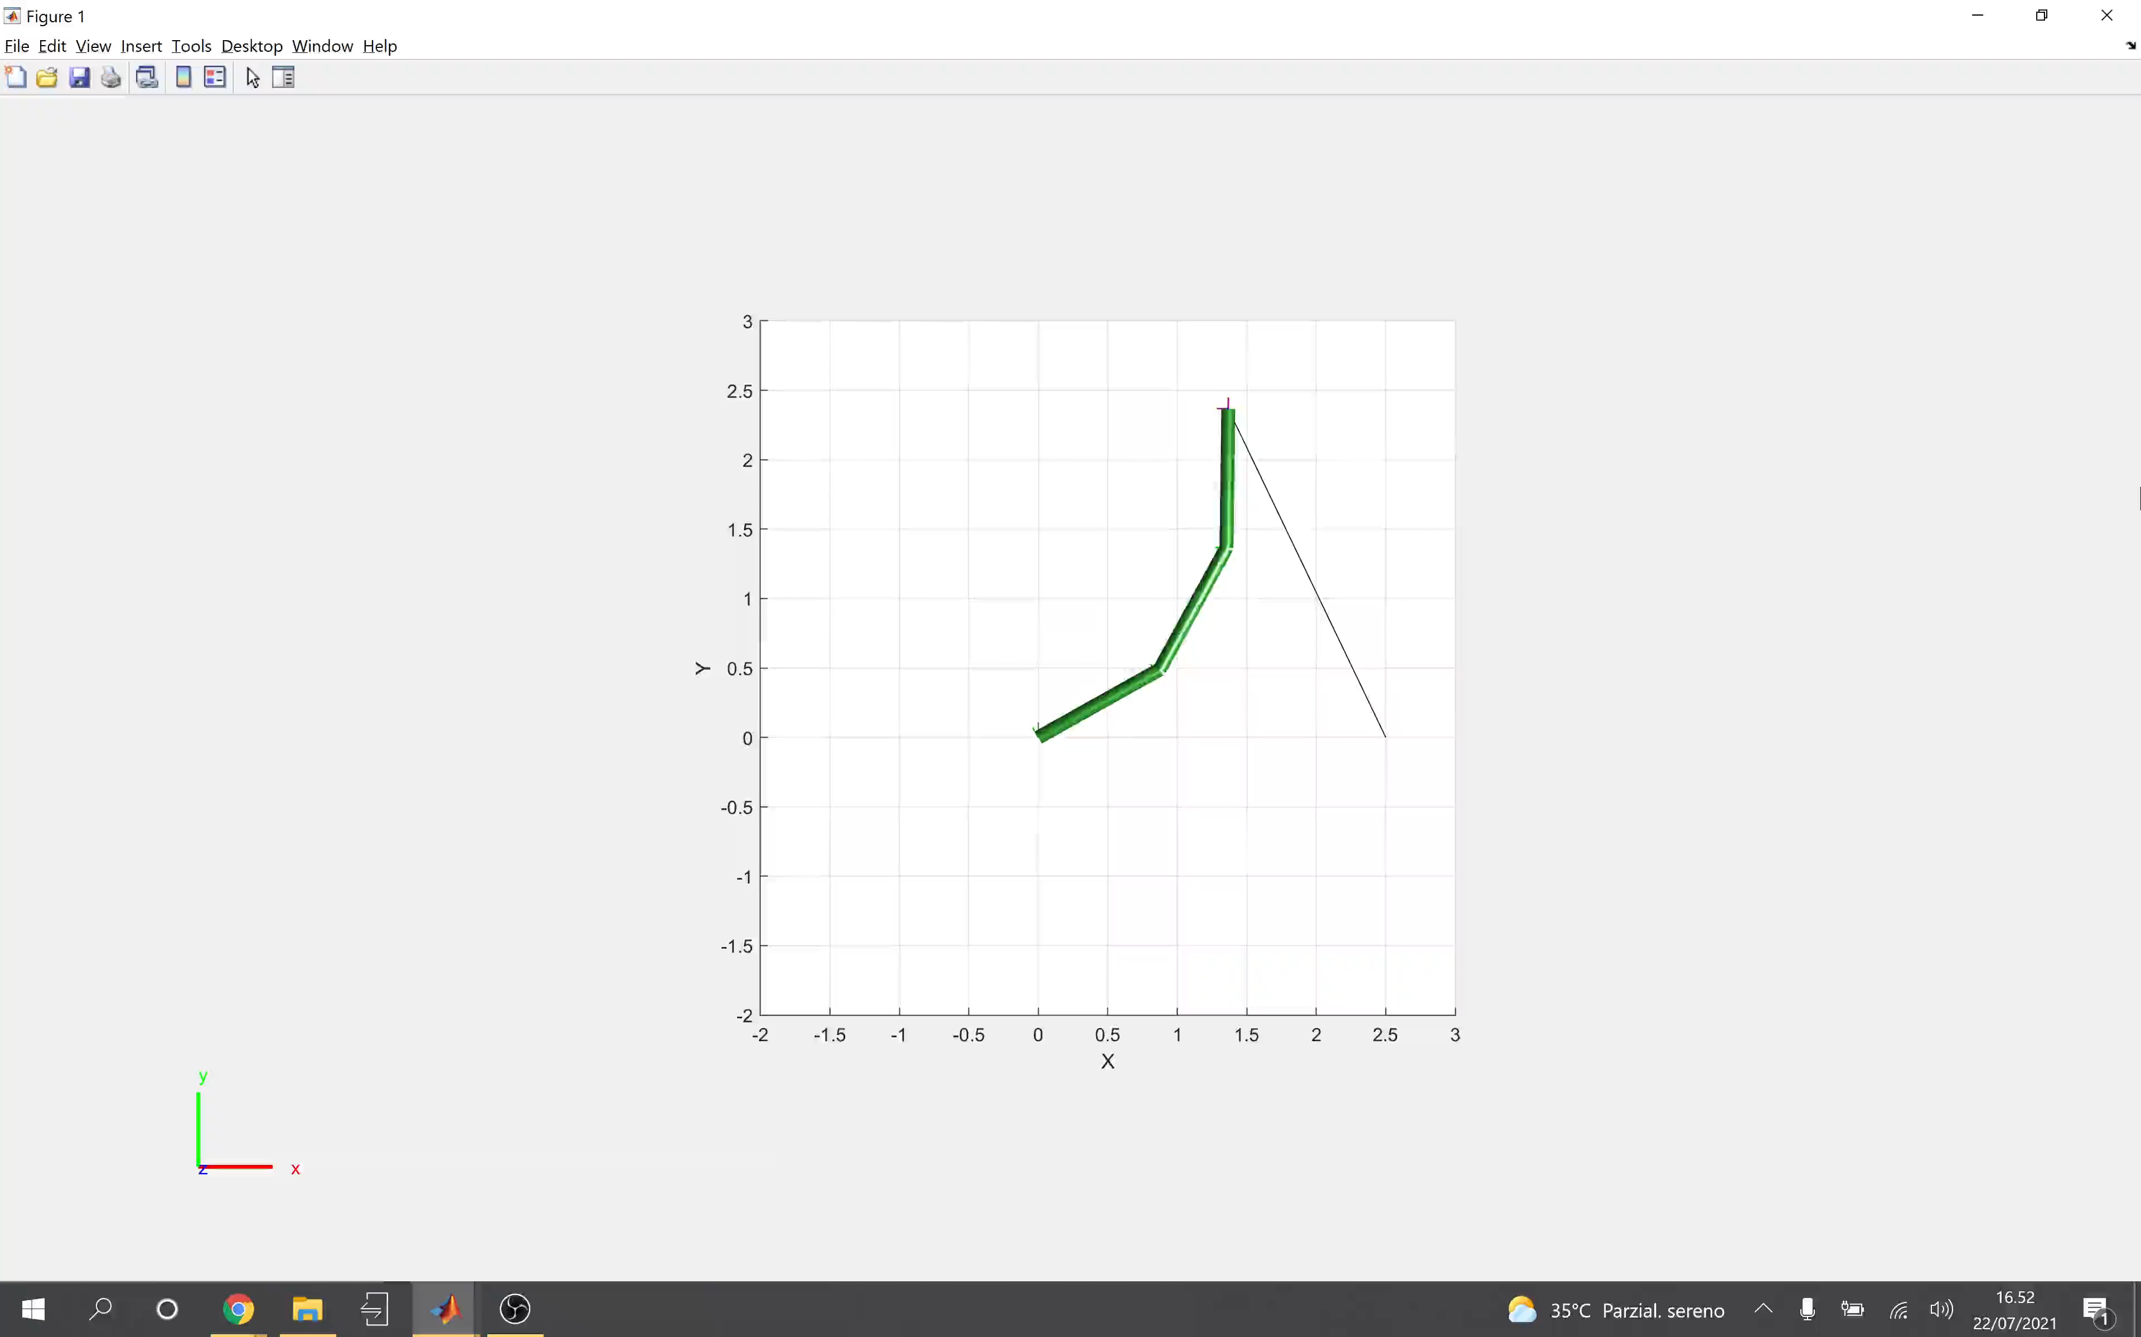
The same task with a damping factor
K = 2

Slide 26
THANK YOU FOR THE ATTENTION
The complete set of simulations and videos is available at the following GitHub Repo:
https://github.com/ErmannoBartoli99/Analysis-of-Inertia-Weighted-Redundancy-Resolution/tree/main/media

